Slide 1

Team members
Sharad Chandra paudel
Abhishek Man Napit
Kritiz Shrestha
Ayush Nepal
Rujal shrestha
Anita Lama
Dipesh Tha shrestha
Aman Sahakarmi
A presentation on
TRIGONOMETRY

Slide 2
Trigonometric
Trigonometry is derived from Greek words trigonon (three angles) and metron ( measure).
Trigonometry is the branch of mathematics which deals with triangles, particularly triangles in a plane where one angle of the triangle is 90 degree .
Triangles on a sphere are also studied, in spherical trigonometry.
Trigonometry specifically deals with the relationships between the sides and the angles of triangles,
that is, on the trigonometric functions , and with calculations based on these functions.

Slide 3

HISTORY
The origins of trigonometry can be traced to the civilizations of ancient Egypt, Mesopotamia and the
Indus Valley, more than 4000 years ago.
Some experts believe that trigonometry was originally invented to calculate sundials, a traditional
exercise in the oldest books .
The first recorded use of trigonometry came from the Hellenistic mathematician Hipparchus circa
150 BC, who compiled a trigonometric table using the sine for solving triangles.
The Sulba Sutras written in India, between 800 BC and 500BC, correctly compute the sine of
$π$/4 (45˚) as 1/$\sqrt{2}$ in a procedure for circling the square (the opposite of squaring the circle).
Many ancient mathematicians like Aryabhata, Brahmagupta, Ibn Yunus and Al-Kashi made significant contributions in this field(trigonometry).

Slide 4
Right Angled Triangle
B
► A triangle in which one angle is equal to 90° is called right triangle.
► The side opposite to the right angle is known as hypotenuse.
AB is the hypotenuse
► The other two sides are known as legs.
AC and BC are the legs
c
a
90°
A
C
b

Slide 5

Pythagoras Theorem In any right triangle, the area of the square
whose side is the hypotenuse is equal to the sum of areas
of the squares whose sides are the two legs.
In the figure
${AB}^{2}$=${BC}^{2}$+${AC}^{2}$
Pythagoras Theorem
B
c
a
90°
A
C
b

Slide 6
Trigonometric Ratios
Sine(sin) opposite side/hypotenuse
Cosine(cos) adjacent side/hypotenuse
Tangent(tan) opposite side/adjacent side
Cosecant(cosec) hypotenuse/opposite side
Secant(sec) hypotenuse/adjacent side
Cotangent(cot) adjacent side/opposite side

Slide 7
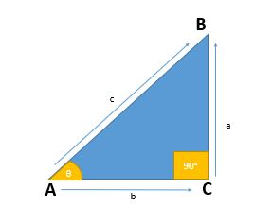
Value of Trigonometric Function of Angle “A”
sinθ= a/c
cosθ = b/c
tanθ = a/b
cosecθ = c/a
sec θ = c/b
cotθ = b/a

Slide 8
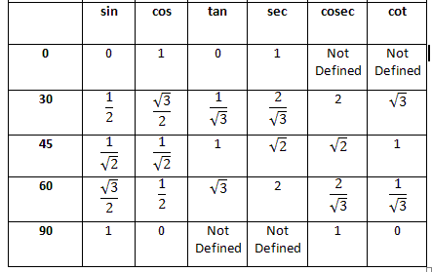
Value of Trigonometric Function

Slide 9
Measuring Angles:
When two lines intersect, they give rise to four different spaces
with respect to the point of intersection.
Angles are commonly measured in degrees denoted as °.
When an object moves through a complete cycle, it has covered
360 degrees (360°). Therefore a degree is 1/360 of a cycle.

Slide 10
Greater angles than 360 degree
We have discussed that when an object makes one complete cycle around a point, it covers 360°,
however, when an object makes more than one cycle, it makes an angle greater than 360 degrees.
This is a common occurrence in day to day life. A tire makes numerous cycles when a vehicle is
being driven hence; it makes an angle greater than 360°.
To find out the number of cycles made when an object rotates, we count the number of times 360
can be added to it to get a number equal to or less than the angle given.
Likewise, we find the number than can be multiplied by 360 to get a number less than but closer to the
angle given.

Slide 11
Example:
Find out the number of cycles made when an object makes an angle of a) 380°
Solution 380 = (1 × 360) + 20 The object makes one cycle and 20° Since 20⁰ =20/360=1/18 cycles The object makes 1 1/18 cycles

Slide 12

Example:
Find out the number of cycles made when an object makes an angle of 770°
Solution:
2 × 360 = 720 770 = (2 × 360) + 50 The object makes two cycles and 50° 500= 50/300 =5/36 cycles
6050​=365​ cycles The object makes 2$\frac{5}{36}$

Slide 13
Positive and Negative angles
When an object rotates in an clockwise direction, it makes a negative angle of rotation while when it
rotates.
In anticlockwise direction, it makes a positive angle.
This implies that given a negative angle, we can get its respective positive angle. For instance, the bottom part of the vertical line is 270°. When measured in the negative direction its
will be -90°. We simply subtract 270 from 360. Given a negative angle, we add 360 to get its
corresponding positive angle. When an angle is -360°, it implies that the object made more than one cycle in clockwise direction.

Slide 14
Example
Find the corresponding positive angle of a) -35° b) -60° c) -180° d) - 670°
Solution 1. We add 360 to the angle to get its corresponding positive angle. a) -35°= 360 + (-35) = 360 - 35 = 325° b) -60°= 360 + (-60) = 360 - 60 = 300° c) -180°= 360 + (-180) = 360 - 180 = 180° d) -670°= 360 + (-670) = -310 That is one cycle in clockwise direction (360) 360 + (-310) = 50° The angle is 360 + 50 = 410°

Slide 15
Example:
2. Find the corresponding negative angle of 80°, 167°, 330°and 1300°.
Solution:
We subtract 360 from the angle to get its corresponding negative angle. 80° = 80 - 360 = - 280° 167° = 167 - 360 = -193° 330° = 330 - 360 = -30° 1300° = 1300 - 360 = 940 (one cycle made) 940 - 360 = 580 (second cycle made) 580 - 360 = 220 (third cycle made) 220 - 360 = -140° The angle is -360 - 360 - 360 - 140 = -1220° Thus 1300° = -1220°

Slide 16
Radian:
A radian is an angle made at the center of circle by an arc which is equal to the length of the radius
of that particular circle. It is therefore a unit that is used to measure an angle.
The angle is approximately to 57.3°.
In most cases, it is denoted by rad.
1 rad ≈ 57.3°
Radians are commonly given in terms of π to avoid dealing with decimals in calculations. In most books, the abbreviation rad is not provided, but the reader has to know that when talking about an angle that is given in terms of π, the units are automatically radians.

Slide 17
Some basic angles in radians:
360° = 2π rad
180° = π rad
90° = 2 π rad
30° = 30/180 π = π/6 rad
45° = 45/180 π = π/4 rad
60° = 60/180 π = π/3 rad
270° = 270/180 π = 27/18π = 1½ π rad

Slide 18
Example
Convert 240°,45°,270°,750° and 390° into radians in terms of π.
Solution
We multiply the angles by π/180
240=240*π/180=4/3π=1½π

Slide 19
Example
Convert the following angles into degrees.
a) 5/4 π
b) 3.12 π
c) 2.4 radians
Solution : we know, 180°=π
a) 5/4π= 5/4 *180°=225°
b) 3.12π= 3.12*180°=561.6°
c) 1 rad= 57.3°
=(2.4*57.3)=137.52°

Slide 20
Negatives angles and angle greater than 360.
•To convert a negative angle to a positive, we add 2π to it.
•To convert a positive angle to a negative, we subtract 2π from it. Example :
1. Convert −3 /4π and −5 /7π to positive angles in radians.
Solution
We add 2π to the angle
−3 /4π=−3 /4π+2π=5 /4π=11/4π
−5/7 π=−5/7 π+2π=9/7π=12/7 π
When an object rotates through an angle that is greater than 2π; it would have made more than one cycle.’
To determine the number of cycles of such angle, we find a number when multiplied by 2π, the
result is equal or less but closer to the number.

Slide 21
Example
1. Find the number of cycles made when an objects rotates through the following angles
a) −10π
b) 9π
c) 7/2 π
Solution
a) −10π=5(−2π)
since −2π implies one cycle in clockwise direction, it implies that the object made 5 cycles in the
clockwise direction.
b) 9π=4(2π)+π, π= half cycle the object made four and half cycles in the anticlockwise directions.
c) 7/2 π=3.5π=2π+1.5π, 1.5π is a three quarter cycle(1.5π/ 2π =3 /4) the object made one and three
quarter cycles in anticlockwise direction

Slide 22
Pythagorean Identities
Sin²θ+cos²θ=1
1+tan²θ= sec²θ
1+cot²θ= csc²θ
Negative Angle identities
sin(-θ)= -sinθ cos(-θ)= cosθ tan(-θ)= -tanθ
cos(-θ)= -cosθ sec(-θ)= secθ cotθ= -cotθ

Slide 23
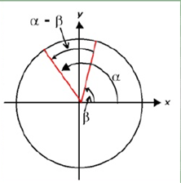
Trigonometric Identities
sin²(A) + cos²(A) = 1
tan²(A) + 1 = sec²(A)
1 + cot²(A) = csc²(A)
sin(A + y) = sin(A) cos(y) + cos(A) sin(y)
sin(A – y) = sin(A) cos(y) – cos(A) sin(y)
cos(A + y) = cos(A) cos(y) – sin(A) sin(y)
cos(A – y) = cos(A) cos(y) + sin(A) sin(y)
tan(A +y) = (tan A + tan y)/ (1−tan A •tan y)
tan(A−y) = (tan A–tan y)/ (1+tan A • tan y)
sin(2A) = 2sin(A) • cos(A)
cos(2A) = cos²(A)–sin²(A)
tan(2A) = [2tan(A)]/ [1−tan²(A)]

Slide 24
Relation Between Different Trigonometric Identities
Sine Cosecant
Cosine Secant
Tangent Cotangent

Slide 25
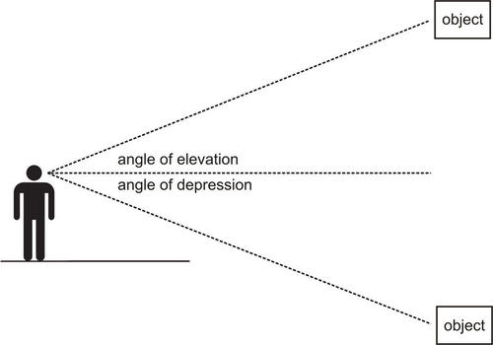
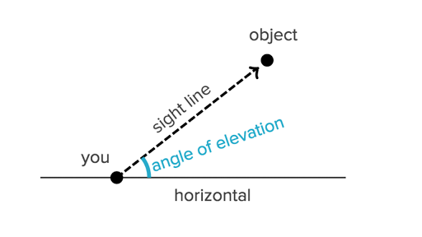
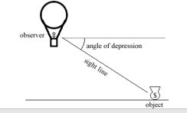
Angles of Elevation and Depression
Line of sight: The line from our eyes to the object, we are viewing.
Angle of Elevation: The angle through which our eyes move
upwards to see an object above us
Angle of depression: The angle through which our eyes move downwards to see an object below us.

Slide 26

Example:
The angle of elevation of the top of a pillar as observed on lying down at a distance of 30 m. from the pillar is 30⁰.Find the height of the pillar.
Solution:
Let, h be the height of tower and d be the base;
From right angled triangle where,
$$Ɵ=30°$$
$$\frac{p}{b}=tanƟ$$
$$\frac{h}{30}=tan30$$
h= 30 tan 30$°$
$$h=30∗1/\text{√}\text{3 }$$
: . h= 10$\text{√}\text{3 } \text{m}$
h
30 º
30m

Slide 27

Example
A pilot flying at an altitude of 915 m. sighted an airport at an angle of depression of 60 0 .How far was he horizontally from the airport?
Solution:
Let, l be the distance;
From right angled triangle where
$$Ɵ=60°$$
$$\frac{b}{h}=cosƟ$$
$$\frac{915}{cos60}= l$$
915*2 = l
: . l = 1830 m
60 º
l

Slide 28
Application of Trigonometry
The use of trigonometry can be found in our daily lives to complex application beyond
Normal person’s imagination.
It is used in fields like:
Astronomy
Navigation
Optics
Biology
Meteorology
Architecture
Computer Graphics
Crystallography
And many more……..

Slide 29
Astronomy
Trigonometry was used in astronomy since ancient time.
Trigonometry is used to measure the distance to nearby stars.
In 240 B.C , a mathematician named Eratosthenes discovered
radius if the earth using trigonometry and geometry.
In 2001, a group of European astronomers did an experiment to
find the distance of Venus from the Sun about 10,50,00,000 Km.
Astronomers use the method of parallax, or the movement of the star against the background as we orbit the sun, to discover new information about galaxies

Slide 30
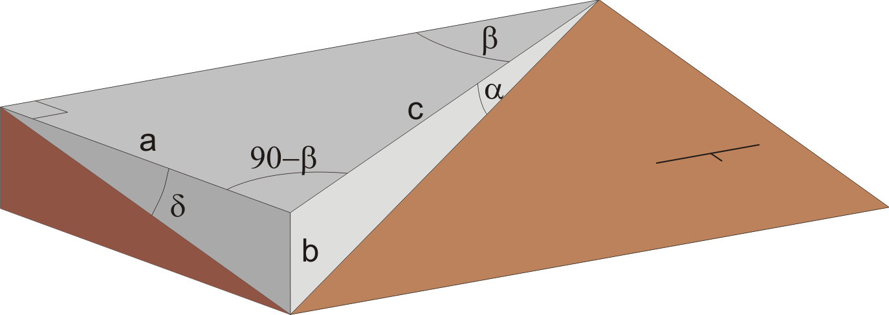
Trigonometry is used in geology to estimate the true dip of bedding angles.
Calculating the true dip allows geologists to determine the slope stability.
Although not often regarded as an integral profession, geologists contribute
to the safety o many building foundations.
Any adverse bedding conditions can result in slope failure and the entire
collapse of a structure.
GEOLOGY

Slide 31
Navigation and Oceanography
It is used in navigation to find the distance of the shore from a point in the sea.
It is used in oceanography in calculating the height of tides in oceans.

Slide 32
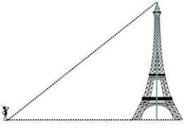
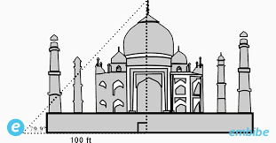
Architects use trigonometry to describe the shapes and forms of a building using numerical
equations. These equations are translated easily by any contractor to
reproduce the exact building the
architect had in mind.
Architects use trigonometry to calculate structural load, roof slopes, ground surfaces and
many other aspects, including sun shading and
light angles.
Architecture

